Slide 1

Operating Systems Design Skilling Session- 10
Adding shared memory IPC to xv6

Slide 2
Shared memory in xv6
In most operating systems, there are some different ways for processes to communicate with one another
In this experiment, you'll explore how to add shared-memory pages to processes that are interested in communicating through memory.

Slide 3
Systems Calls
void* shmgetat(int key, int num_pages)
int shm_refcount(int key)

Slide 4
shmgetat()
void* shmgetat(int key, int num_pages):
It is a simplified combination of the two Linux system calls: shmget() followed by shmat().
The idea is that if processes call shmgetat() with the same key for the first argument, then they will share the specified number of physical pages.
Using different keys in different calls to shmgetat() corresponds to different physical pages.

Slide 5
Shared memory in xv6
On success, shmgetat() returns the virtual address of the shared pages to the caller, so the process can read/write them.
In all cases, shmgetat should map the shared physical pages to the next available virtual pages, starting at the high end of that process' address space.
Different processes can have the same physical pages mapped to different locations in their virtual address space.

Slide 6
Example
when a process calls shmgetat(0, 1), the OS should map 1 physical page into the virtual address space of the caller, starting at the very high end of the address space; these pages should be zero-filled initially.
The system call returns the virtual address where these pages are mapped into the caller's address space.
If another process then calls shmgetat(0, ANY_VALUE), then this process should also get that same 1 page mapped into its virtual address space (possibly at a different virtual address).

Slide 7
Example (Cont..)
The two processes can then each read and write to this page and thus communicate.
Note: Second argument to shmgetat is ignored if a key that has already been used is passed as the first argument; it maps the same number of pages that were specified in the first call.
Note that if a third or fourth process calls shmgetat(0, ANY_VALUE) then they would have that same page mapped into their address spaces as well.

Slide 8
Example (Cont..)
If another key is used, then this corresponds to a new shared region.
So, if any process then calls shmgetat(1, 3), the OS will map 3 (new)
physical pages into the address space of the calling process and
associate these 3 pages with key value 1.
Subsequent calls that use key=1 will map these three pages into the
calling process' address space.
In all cases, the number of pages that can be specified is small: just up
to 4 pages to a single call to shmgetat().
Keys can range from only 0 to 7.
If any type of error ever occurs, shmgetat should return -1.

Slide 9
shm_refcount().
int shm_refcount(int key).
This call returns, for a particular key, how many processes currently are sharing the associated pages.
If a process exits, you need to decrement this reference count.
If the reference count for a key goes to 0, then all state associated with those pages should be freed.
Thus, if the reference count for a key goes to 0, and then a subsequent call is made to shmgetat(key, SOME_VALUE), this subsequent call will be treated as a new shared segment with a new number of shared physical pages (and the pages appropriately initialized to zero).

Slide 10
Procedure to add shred memory IPC to xv6
Step 1:
[osd-gp3658@team-osd ~]$ git clone https://github.com/hayleejane3/shared-memory-xv6
Step 2:
[osd-gp3658@team-osd ~]$ cd shared-memory-xv6
Step 3:
[osd-gp3658@team-osd shared-memory-xv6]$ ls
Step 4:
[osd-gp3658@team-osd shared-memory-xv6]$ vi Makefile

Slide 11
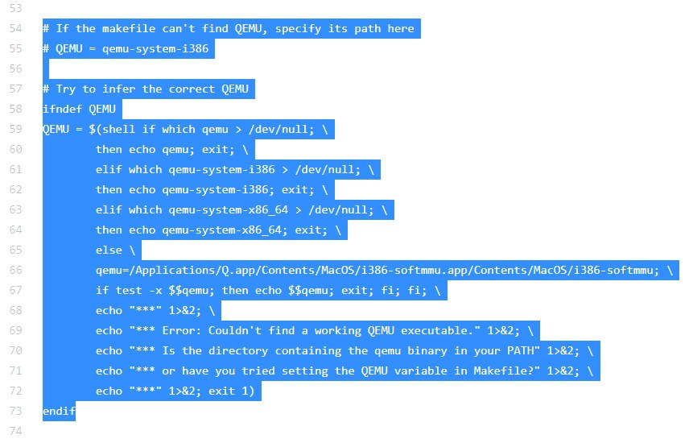
Delete following lines from Makefile

Slide 12
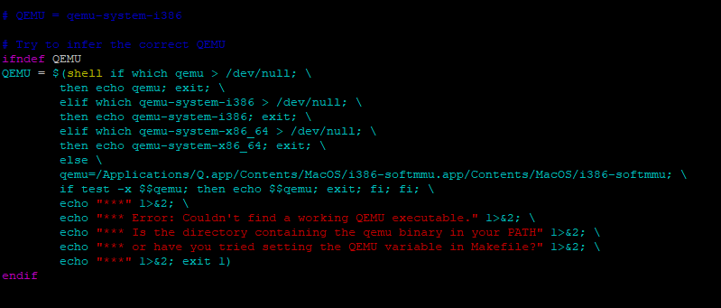
Add following code in-place of deleted code

Slide 13
Procedure to add shred memory IPC to xv6
Step 5:
[osd-gp3658@team-osd shared-memory-xv6]$ cd user
Step 6:
[osd-gp3658@team-osd user]$ls
Step 7:
[osd-gp3658@team-osd user]$ vi test_shm.c

Slide 14
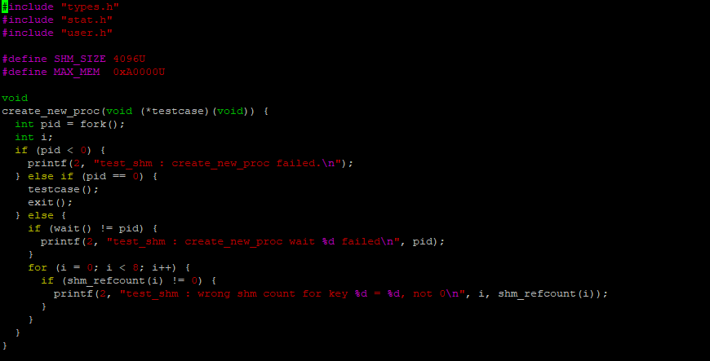
test_shm.c

Slide 15
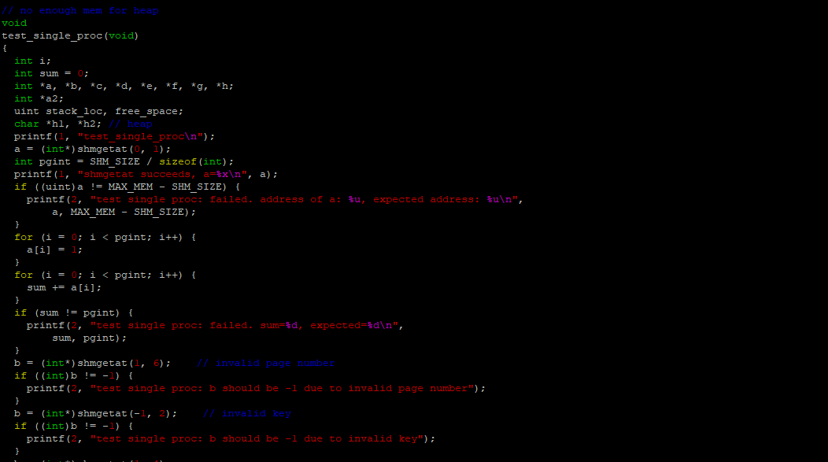

Slide 16
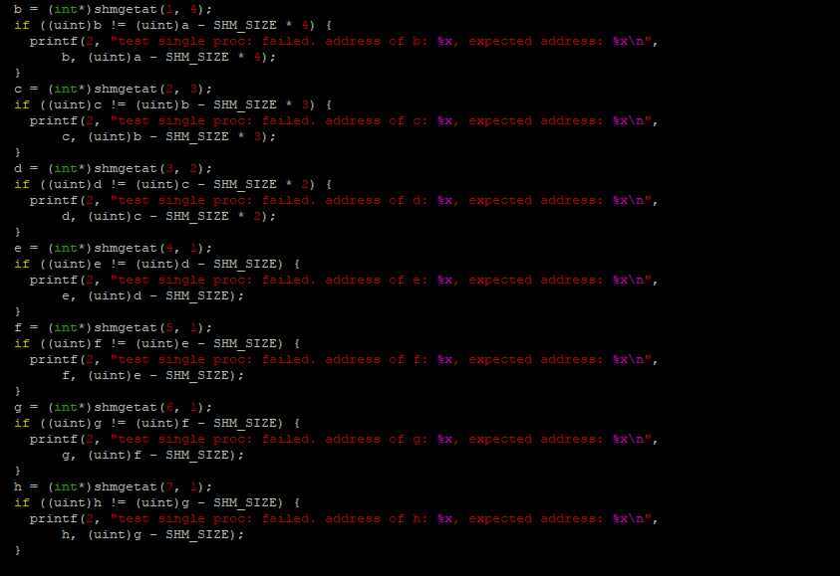

Slide 17
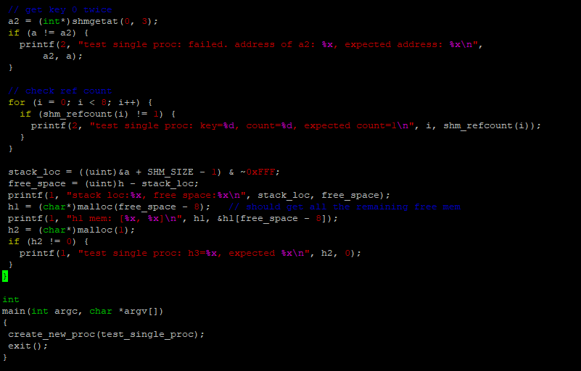

Slide 18
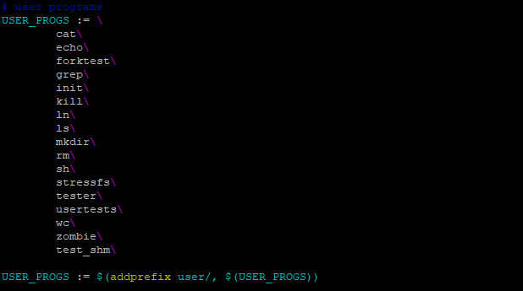
Procedure to add shred memory IPC to xv6
Step 8:
[osd-gp3658@team-osd user]$ vi makefile.mk

Slide 19
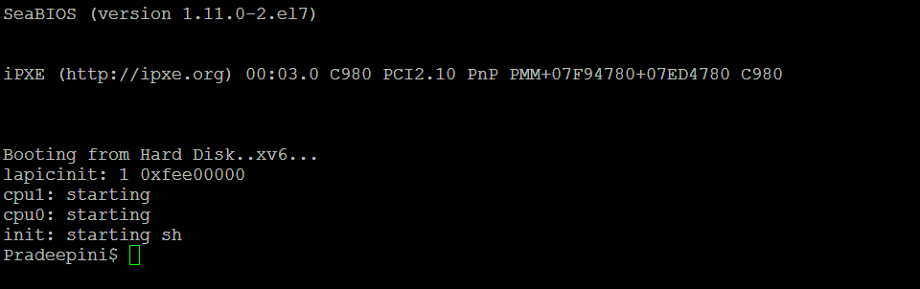
Procedure to add shred memory IPC to xv6
Step 9:
[osd-gp3658@team-osd user]$ cd ..
Step 10:
[osd-gp3658@team-osd shared-memory-xv6]$make qemu-nox

Slide 20
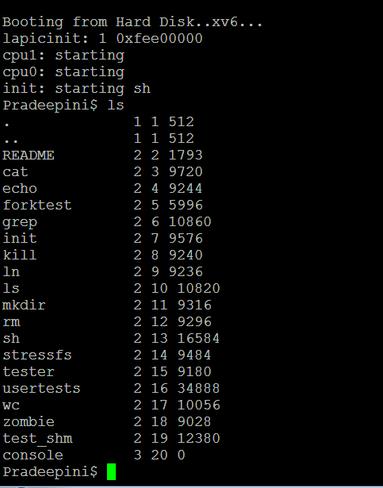

Slide 21
